Slide 1


Project 2 Text Transmission using USRP
By 高荣 曹正阳

Slide 2
Content
Introduction
Result and Analysis
Experiences

Slide 3



Introduction
Complex baseband signal
Complex baseband Signal
For a real signal x(t)

Slide 4


Data Encapsulation
Packet Format

Slide 5

Principles of PSK

Slide 6
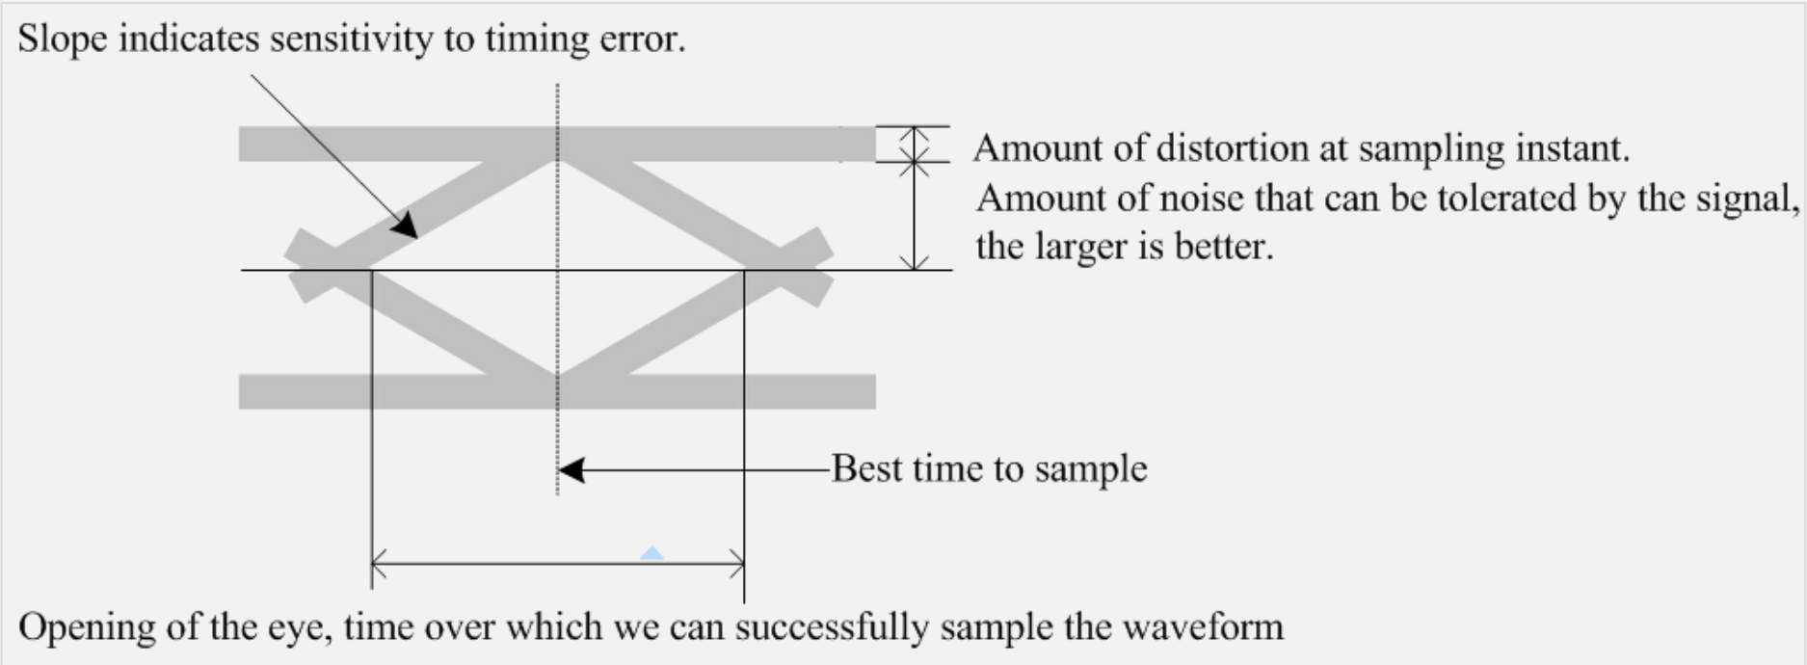
Eye Diagram

Slide 7

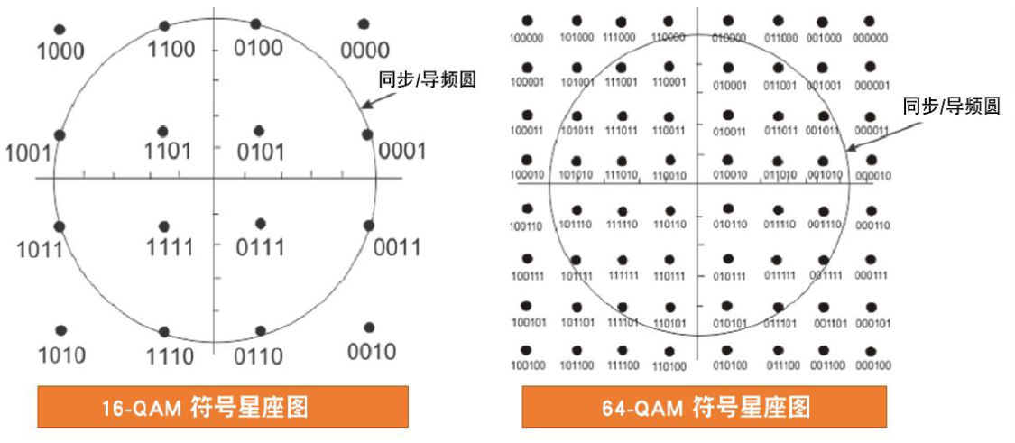
Constellation

Slide 8
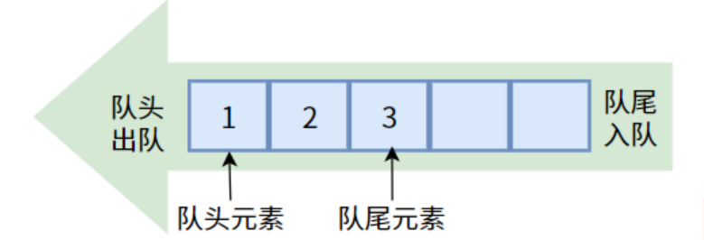
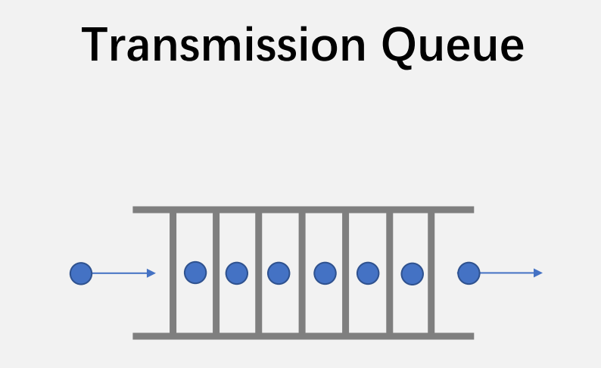
The fundamentals of queues

Slide 9

Producer-consumer model

Slide 10
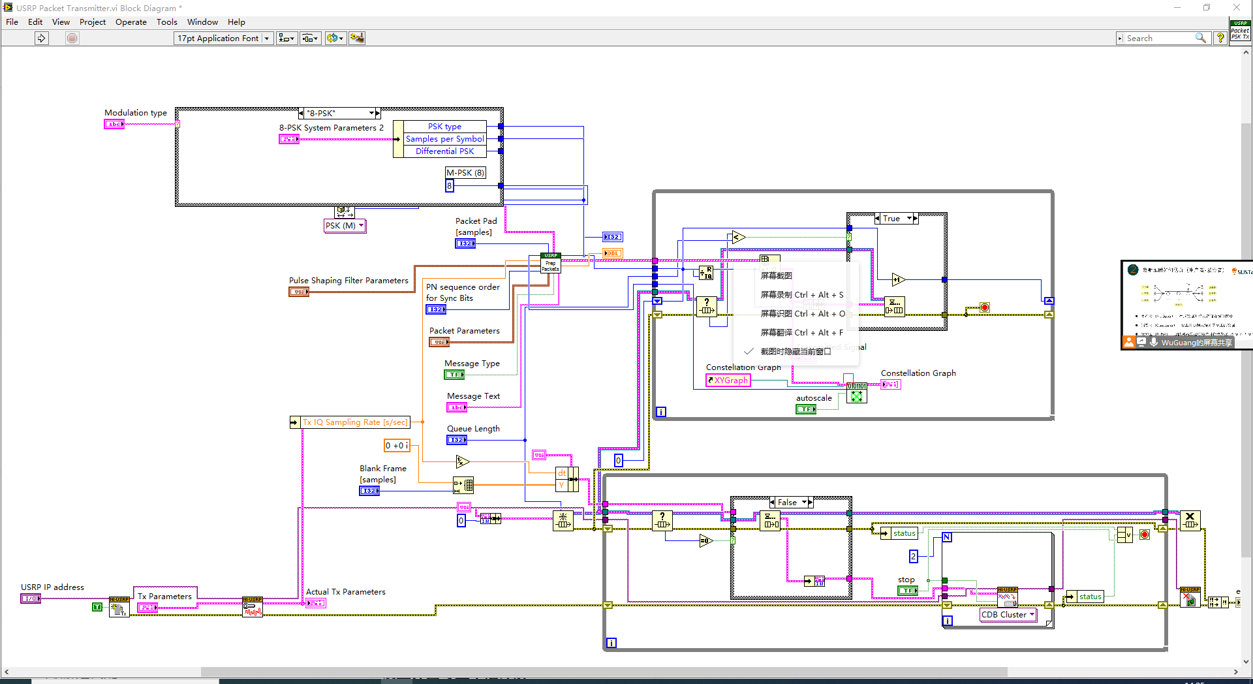
Result and Analysis：

Slide 11
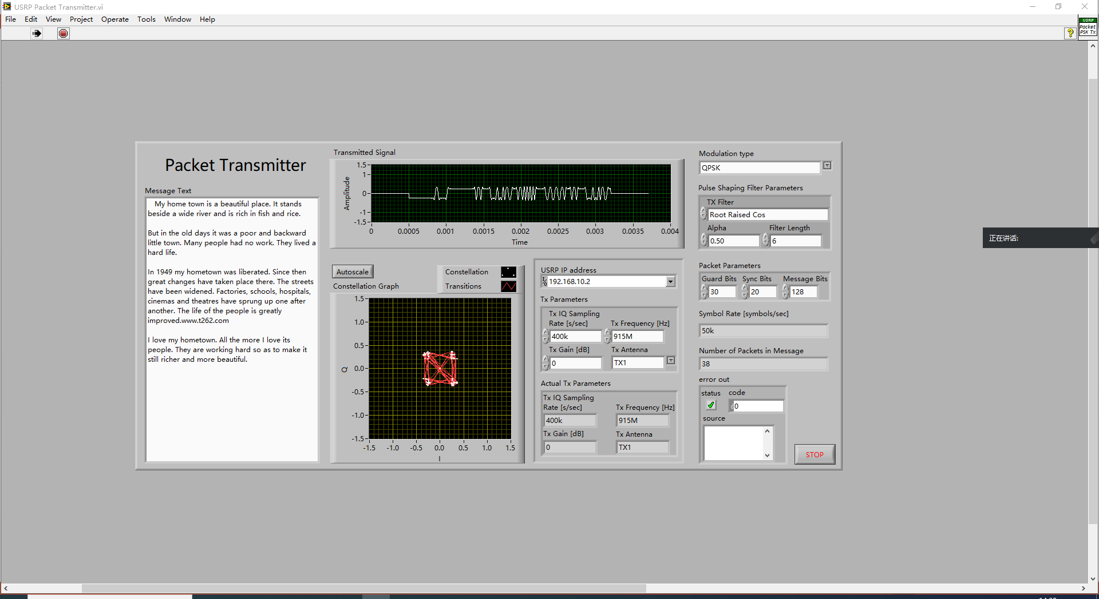
Result and Analysis：

Slide 12
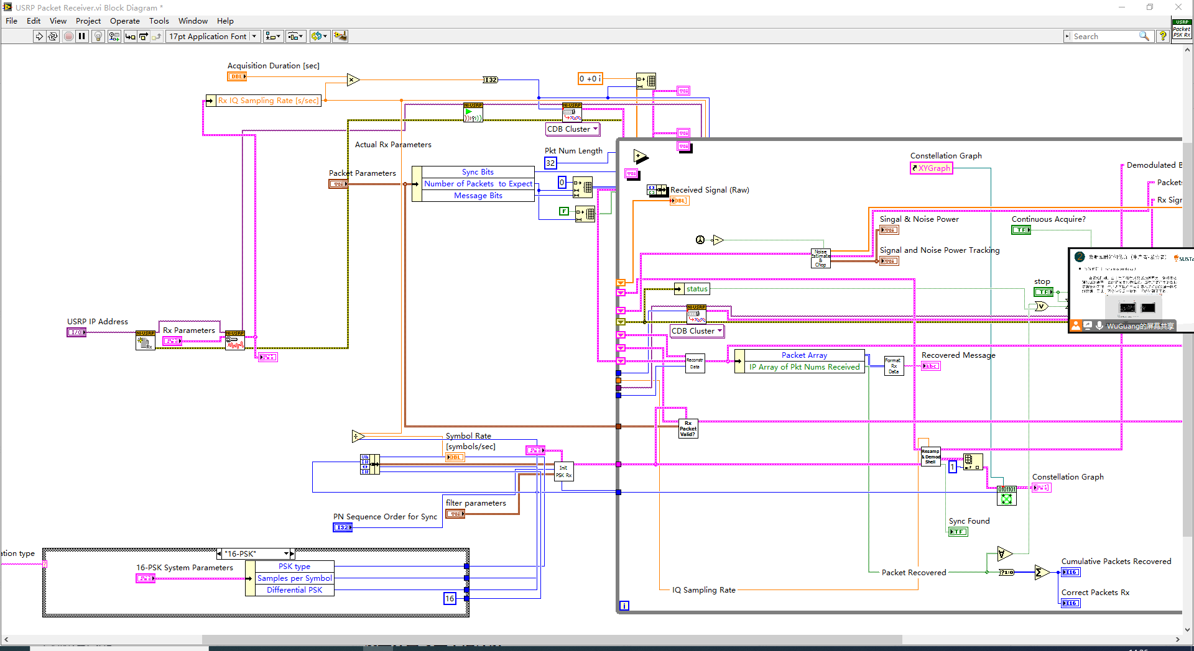
Result and Analysis：

Slide 13
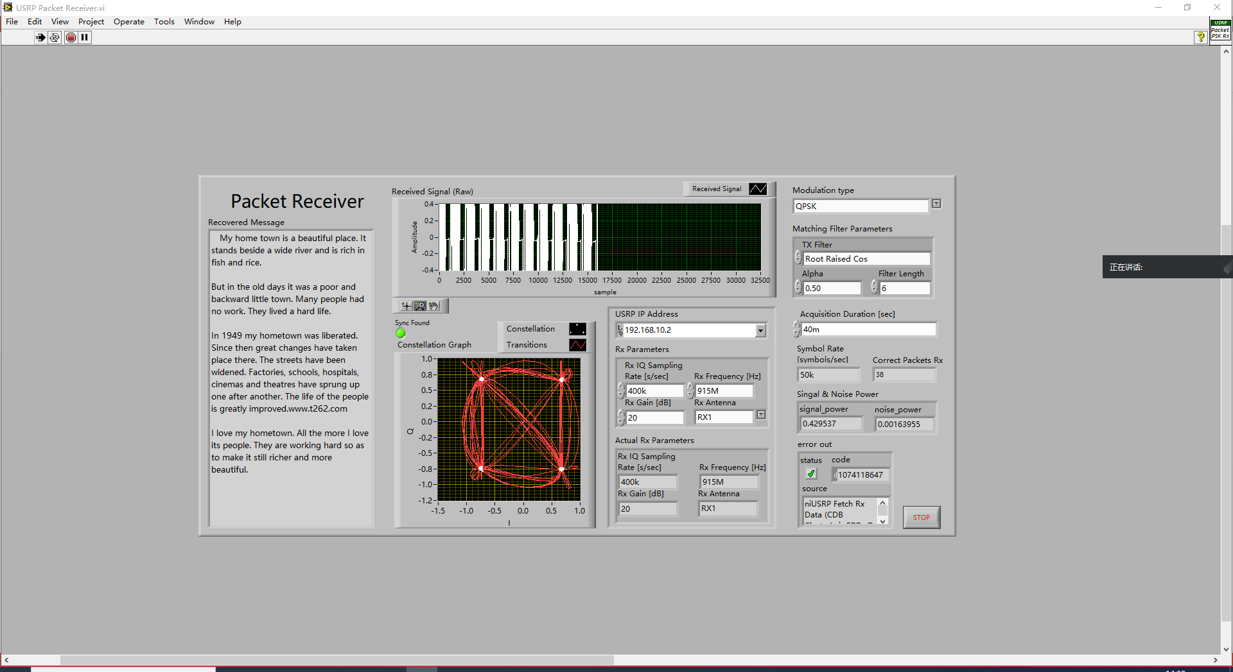
Result and Analysis：

Slide 14
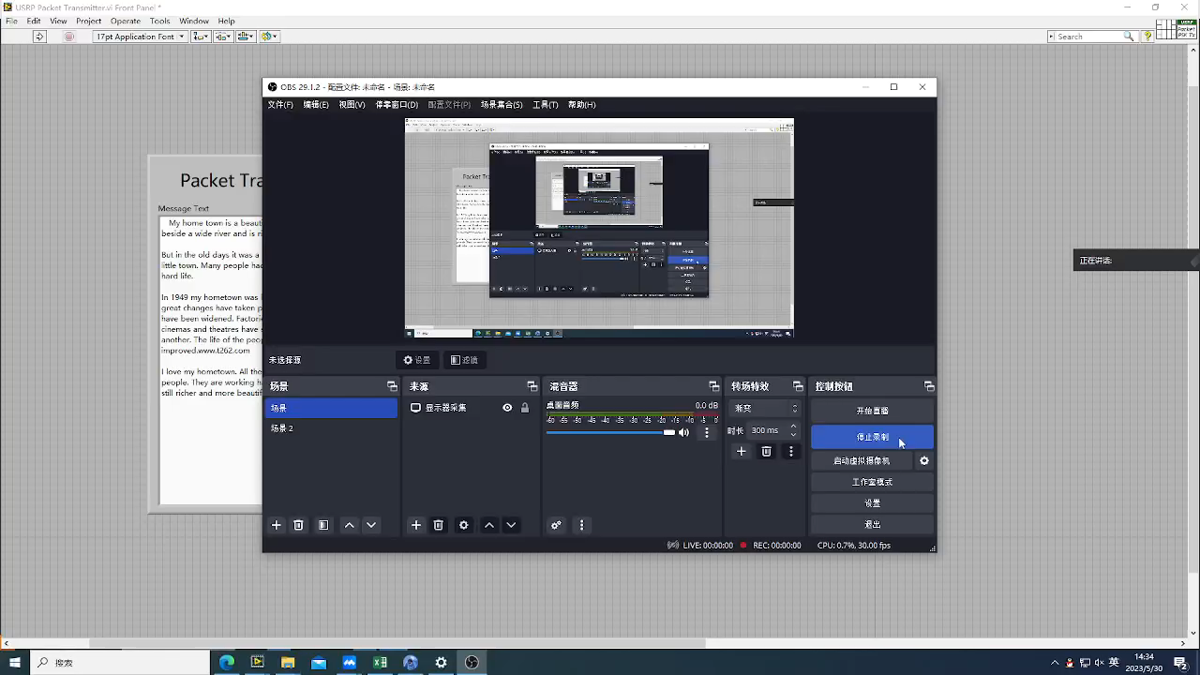
Result and Analysis：

Slide 15
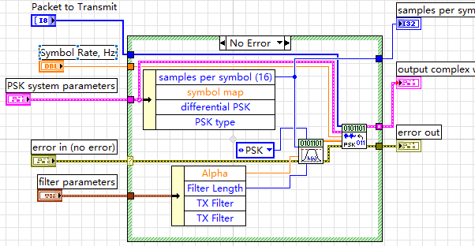
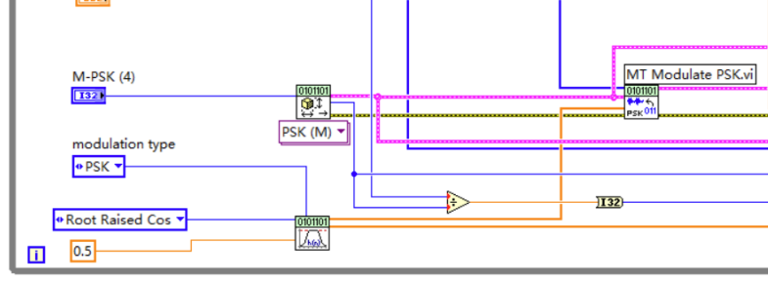
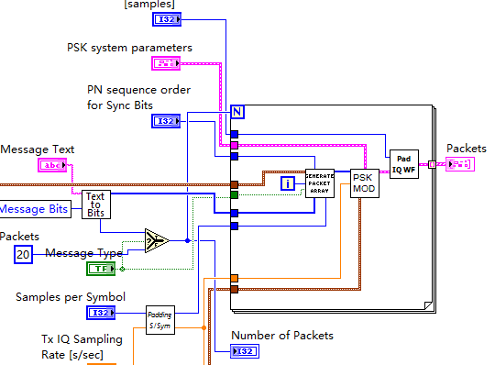
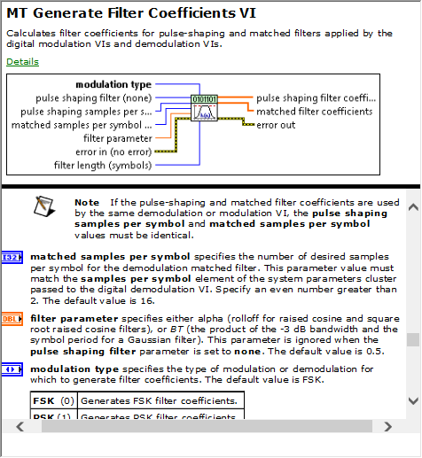
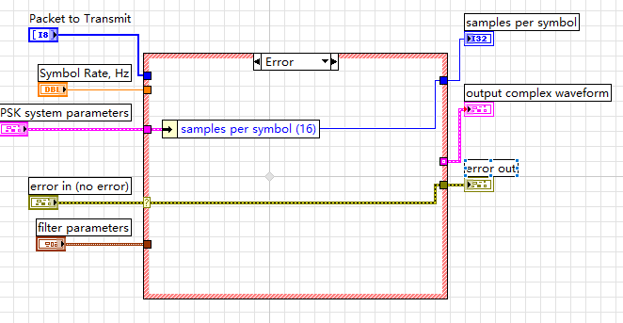
Result and Analysis：

Slide 16
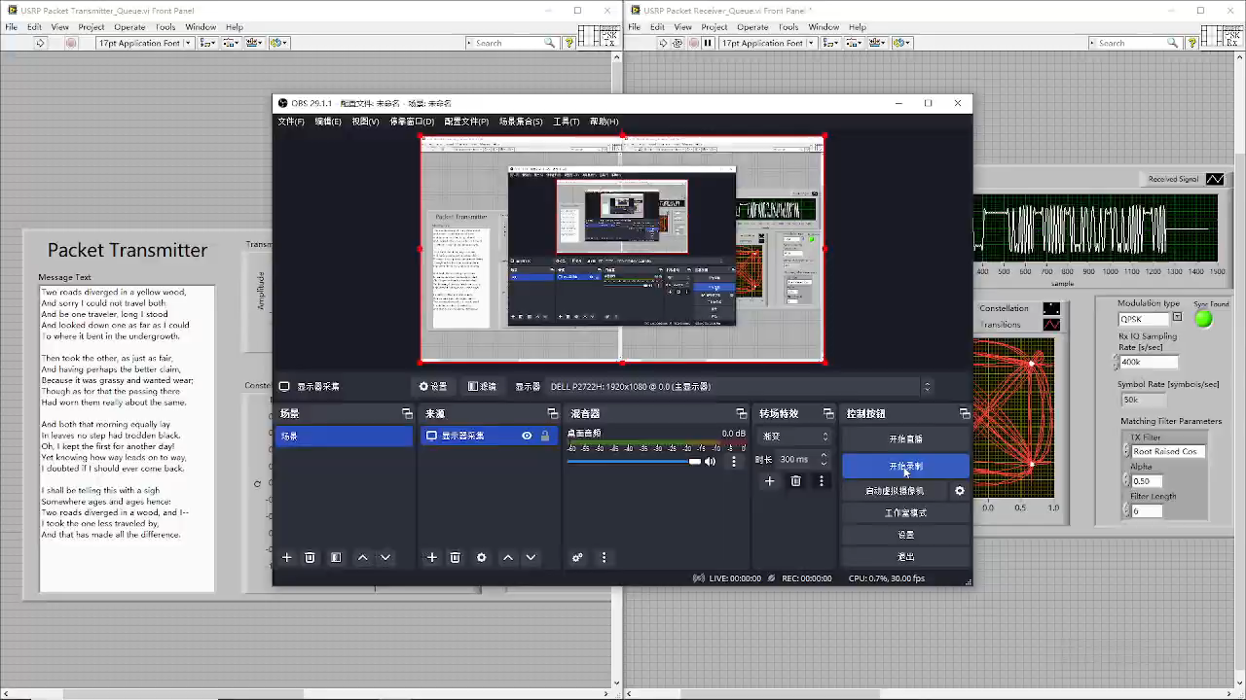
Result and Analysis：

